Slide 1

Is knowledge the biggest asset you can accumulate?
Name : Priyanshu Singh
Uid : 18bet1057

Slide 2
What is Knowledge?
A knowledge is something which you know but cann't touch(intangiable)
A knowledge is a assest with no legal documentation
It comes from your education.
There is no age limit for knowledge.

Slide 3
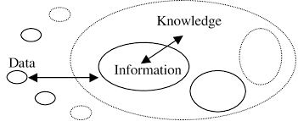
How Knowledge Work?

Slide 4
Benefit of being knowledgeable
You can earn money
Knowledge give you happiness
Knowledge give you confidence
Knowledge and experience go hand in hand

Slide 5
Backbone for Knowledge?
Your communication skill
How you present to other
Your confidence level

Slide 6
Conclusion
Finally we can say knowlede is our greatest assest

Slide 7
Thank You

